Slide 1

“Histograms”
Mikołaj Leszczuk, Jakub Nawała

Slide 2

Talk Structure
Image histograms
Histogram matching (histogram specification)
Histogram equalisation
Image statistics

Slide 3
Image Histograms

Slide 4
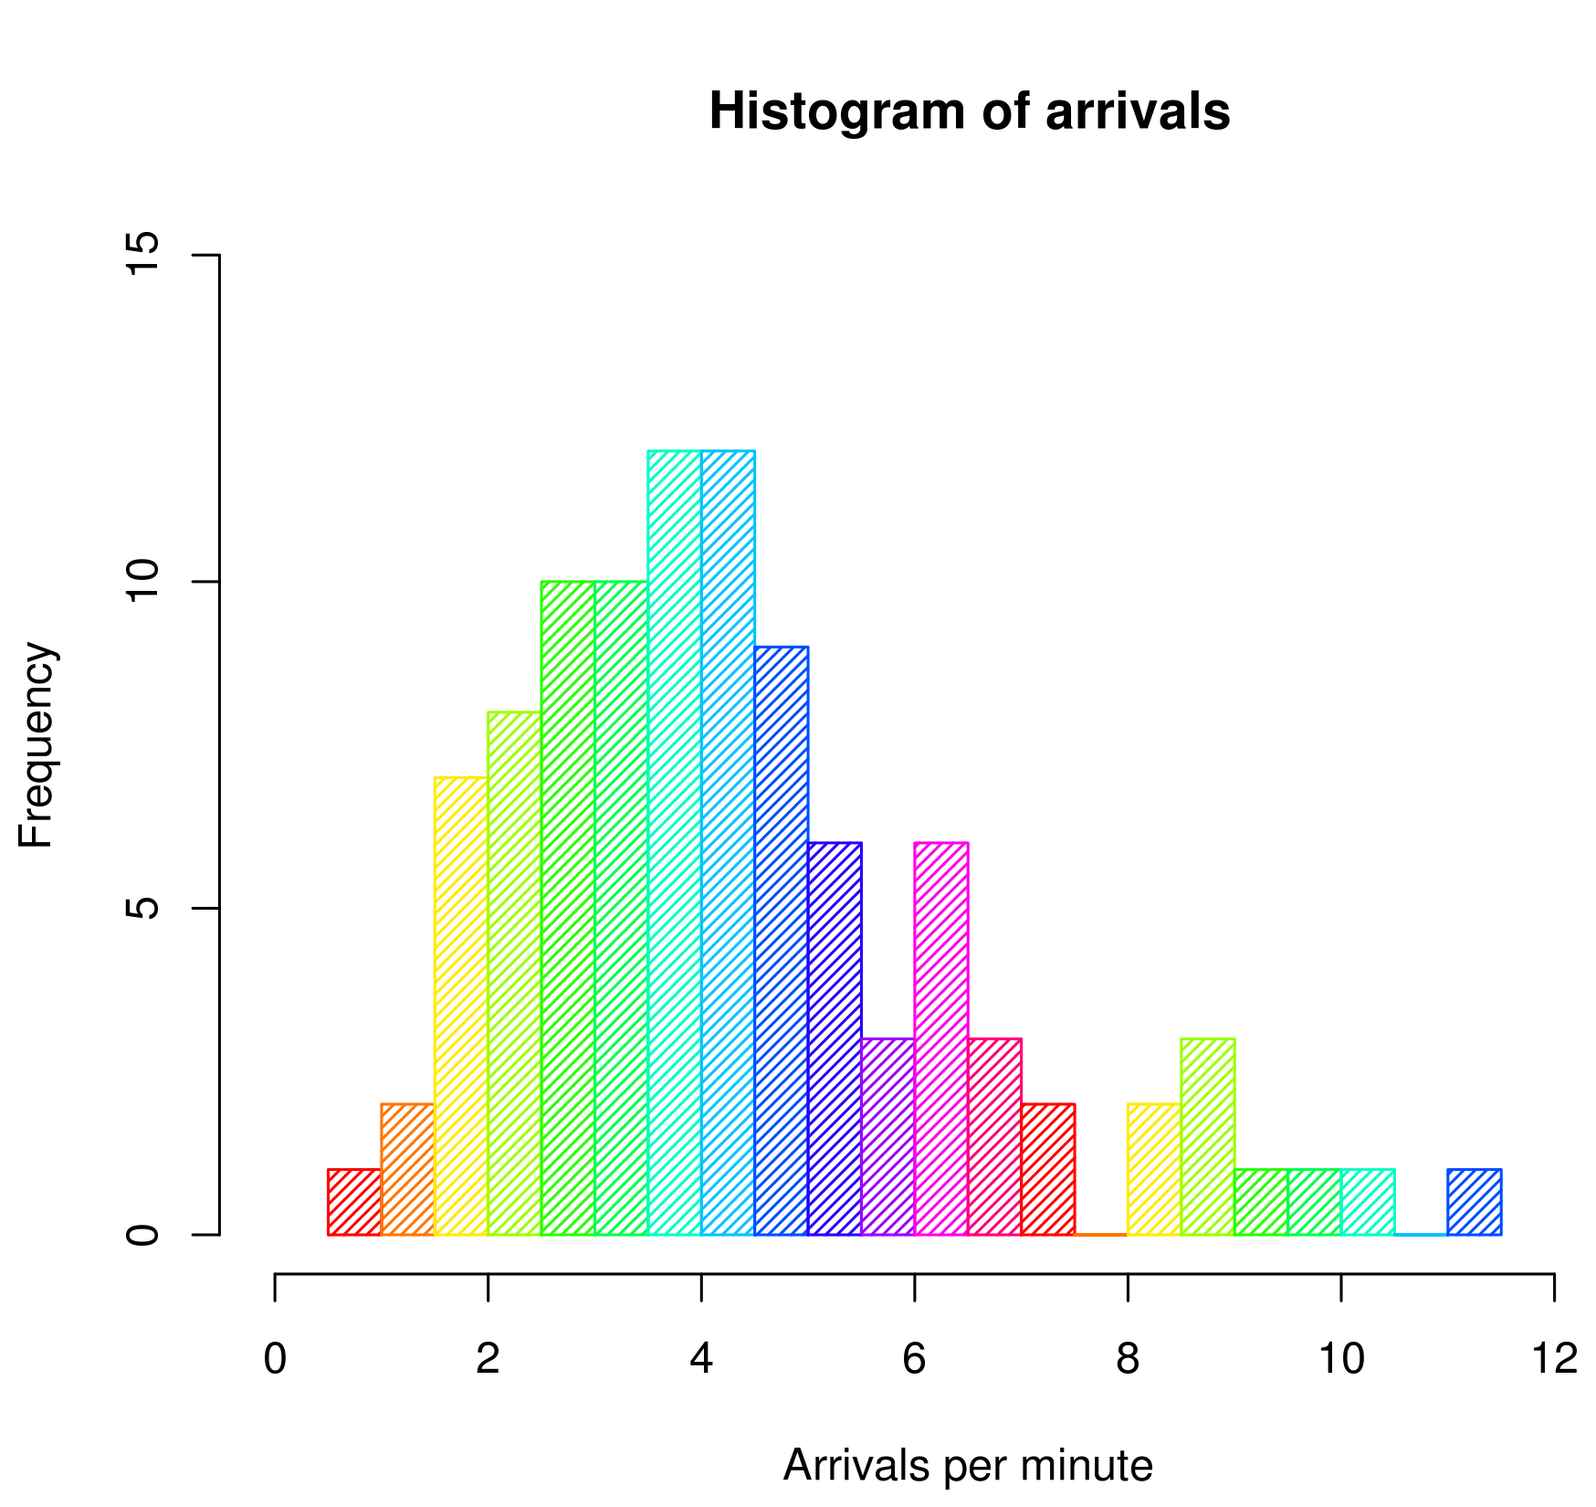
Histogram
Accurate representation of the distribution of numerical data
Estimating probability density function (PDF) of a continuous variable (quantitative variable)
By DanielPenfield - Own work, CC BY-SA 3.0, https://commons.wikimedia.org/w/index.php?curid=9401898
Notes:
Mention why for continuous variables this is just an estimation.

Slide 5
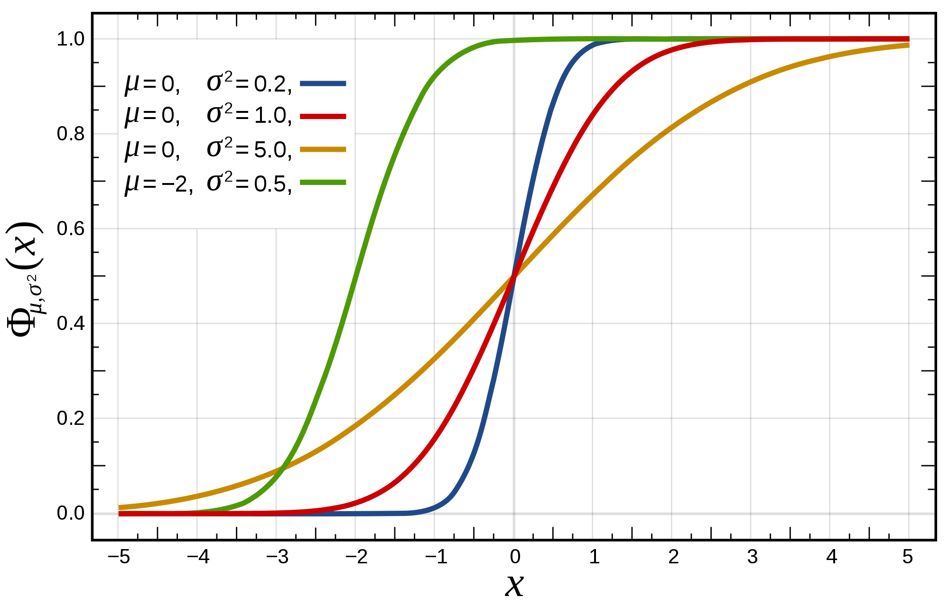
Cumulative Histogram cont.
Histogram represented by Cumulative Distribution Function (CDF)
CDF - probability that X ≤ x.
For example, X - delay between two endpoints in seconds
By Inductiveload - self-made, Mathematica, Inkscape, Public Domain, https://commons.wikimedia.org/w/index.php?curid=3817960
Notes:
Explain a little bit how CDF works.

Slide 6
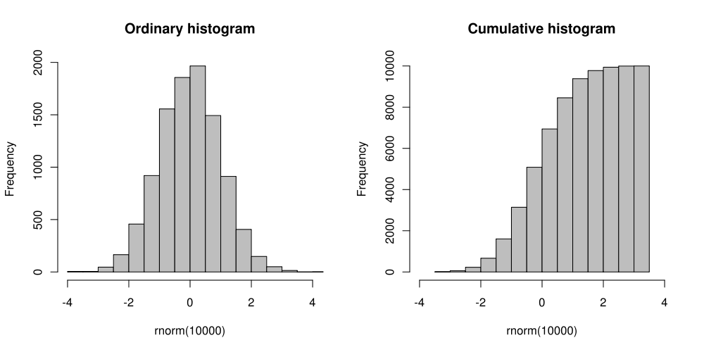
Cumulative Histogram
By Kierano - Own work, CC BY-SA 3.0, https://commons.wikimedia.org/w/index.php?curid=6428627
Notes:
The two represent the same set of numbers.

Slide 7
Image Histogram
A histogram type being a graphical representation of the tonal (color) distribution of a digital image
Plots the number of pixels for each tonal value
Allows judging the entire tonal distribution at a glance
The meaning of axes:
Horizontal – tonal value
Vertical – number of pixels in that tone

Slide 8
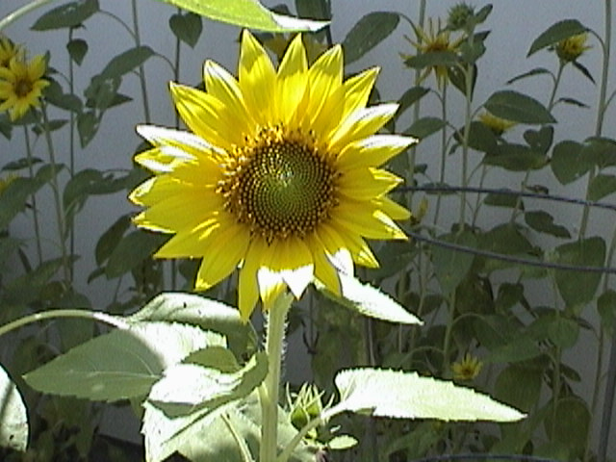
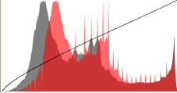
Sunflower Image and Its Histogram(s)
Notes:
Mention where dark (lower end) and where light (higher end) pixels fall on the histogram.
The second (gray) histogram is most probably a potential enhanced version (suggested by the image editing tool).

Slide 9
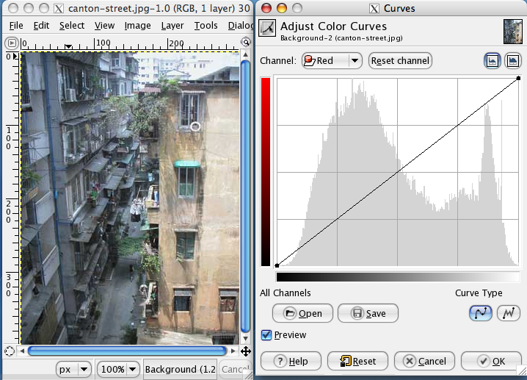
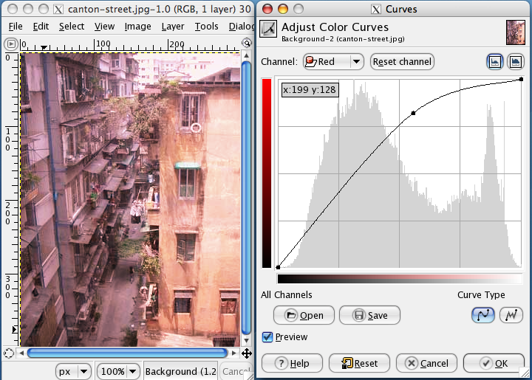
Curve (Tonality)
Photo & the curve dialog in GIMP
The same photo with red colour emphasized in the lighter end of the spectrum
By Magnus Lewan - own photo and screen shot from the Gimp, CC BY-SA 3.0, https://commons.wikimedia.org/w/index.php?curid=1446140
By Magnus Lewan - own photo and screen shot from the Gimp, CC BY-SA 3.0, https://commons.wikimedia.org/w/index.php?curid=1446146
Notes:
Does anyone know the principle of operation of the Curve?

Slide 10
Histogram Matching (Histogram Specification)

Slide 11
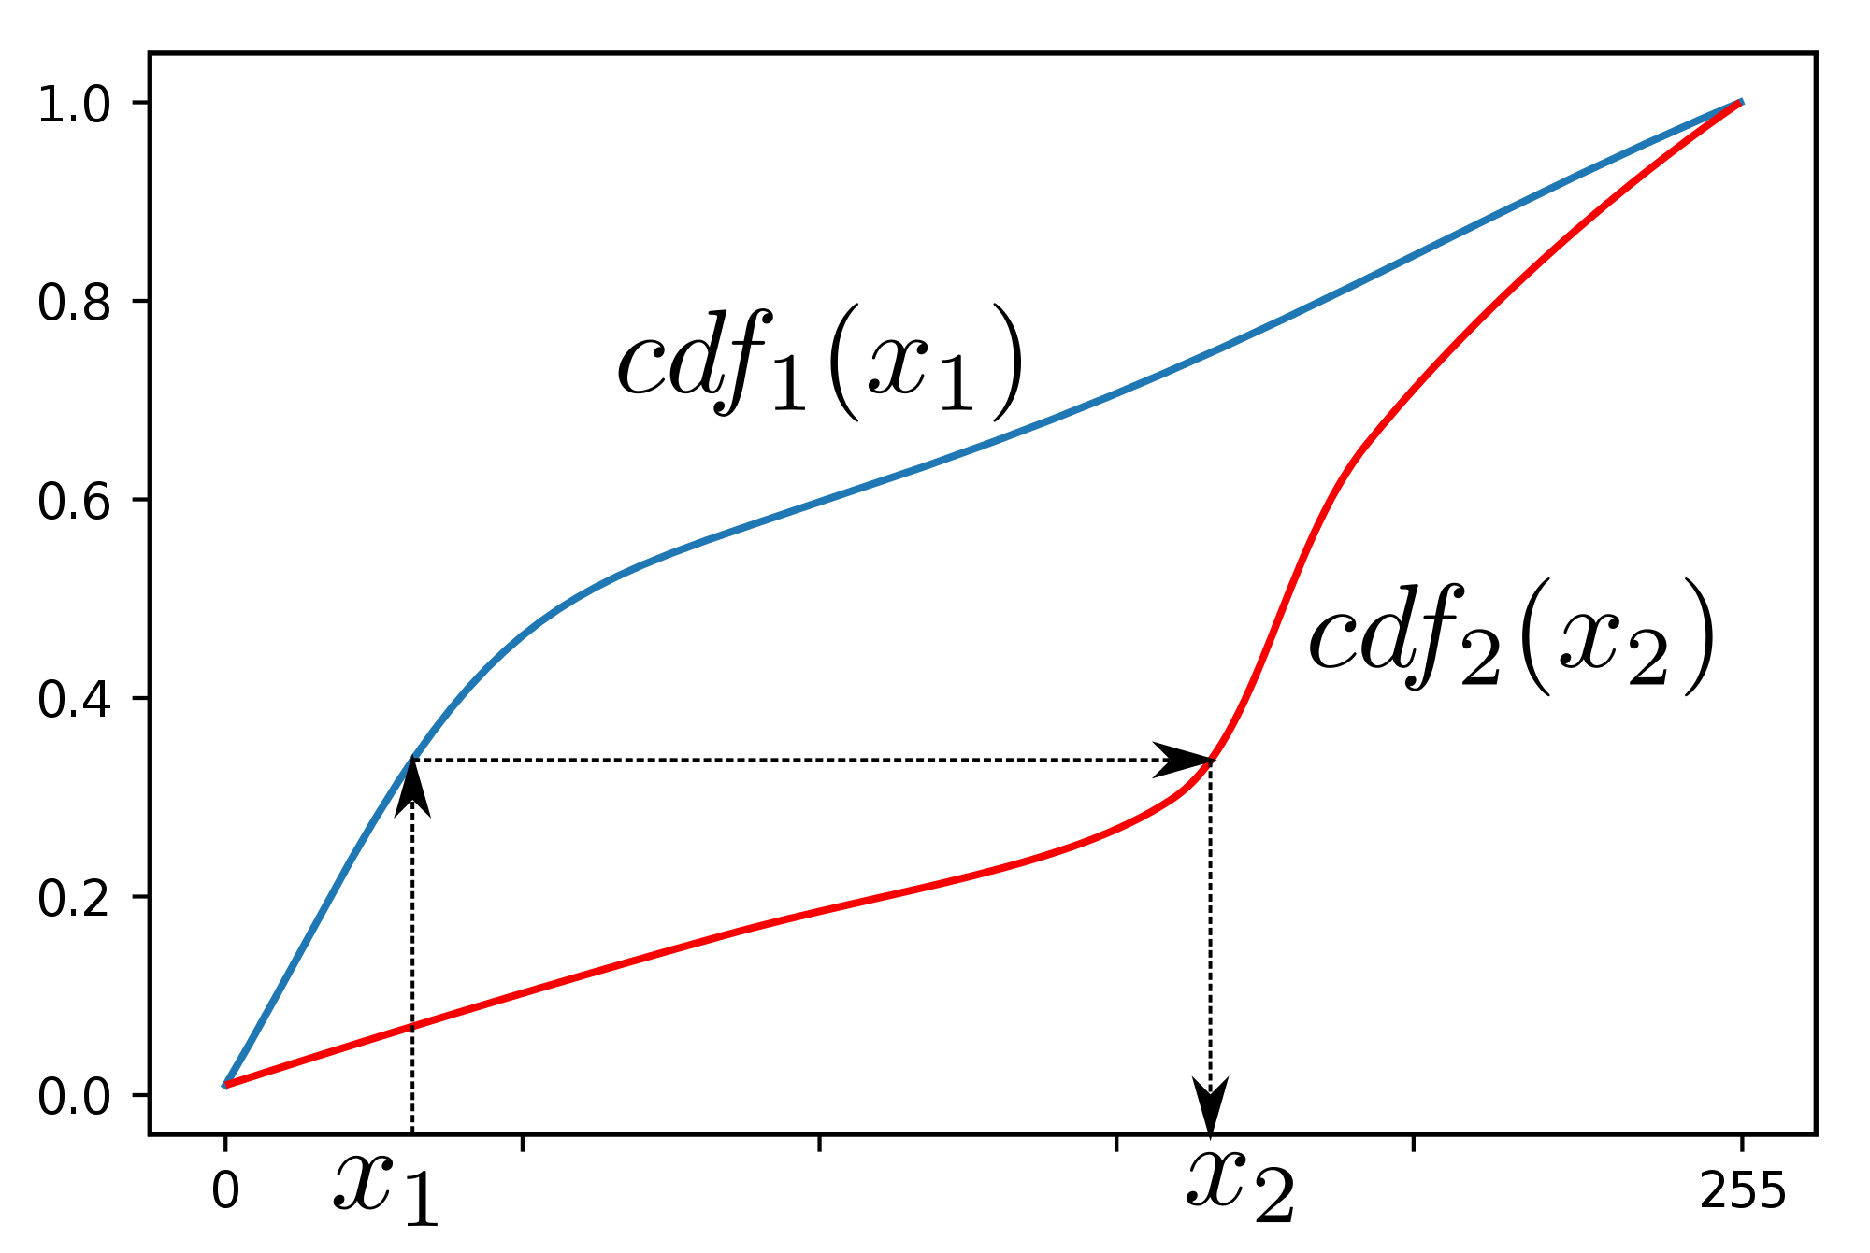
Histogram Matching (Histogram Specification)
Transformation of an image so that its histogram matches a specified histogram
Useful to normalize 2 images, when images acquired at:
The same local illumination (such as shadows) over the same location, but by
Different:
Sensors,
Atmospheric conditions, or
Global illumination.
By Llorenzi - https://commons.wikimedia.org/wiki/File:Histogram_matching.PNG, CC BY-SA 3.0, https://commons.wikimedia.org/w/index.php?curid=65976023

Slide 12
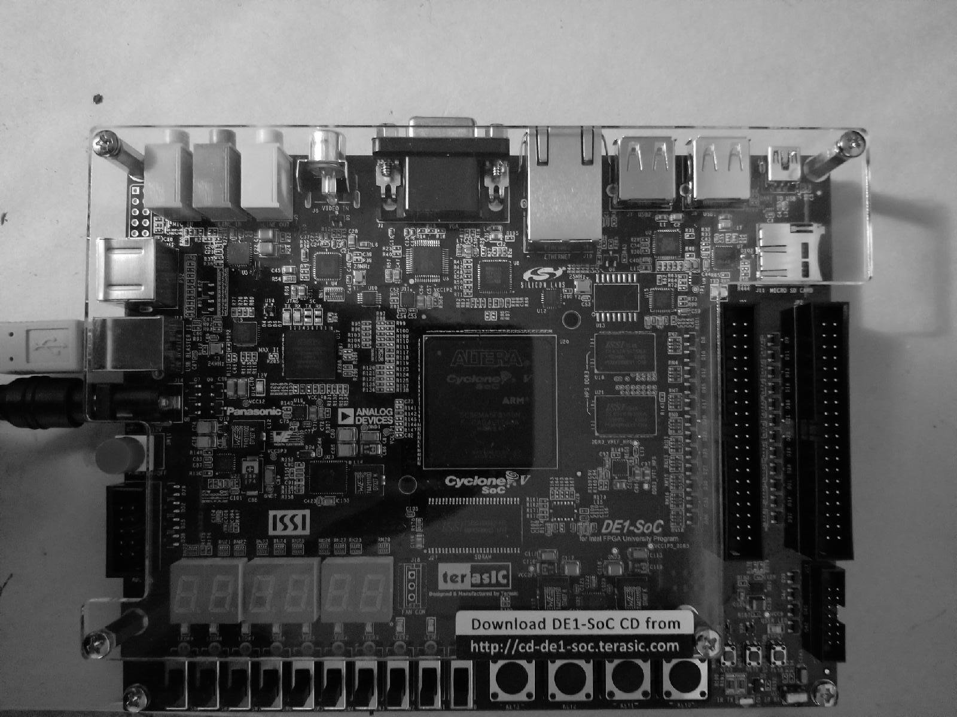
Example
Following input grayscale image to be changed to match a reference histogram:
By Sinonalexander - Own work, CC BY-SA 4.0, https://commons.wikimedia.org/w/index.php?curid=68375000

Slide 13
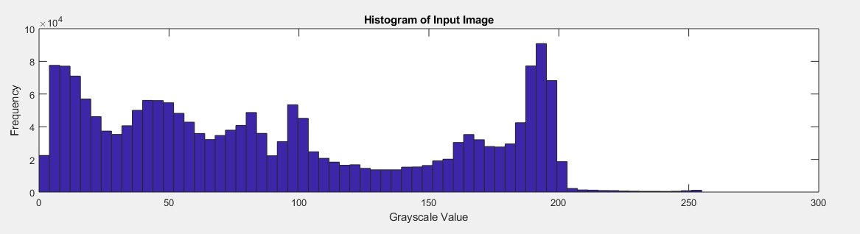
Histogram of Input Image
Input image having following histogram:
By Sinonalexander - Own work, CC BY-SA 4.0, https://commons.wikimedia.org/w/index.php?curid=68375072

Slide 14
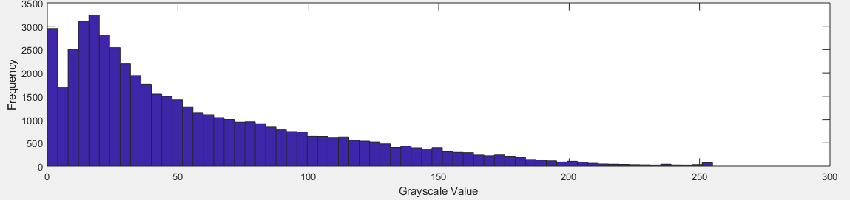
Desired Reference Histogram
To be matched to this reference histogram to emphasize lower gray levels:
By Sinonalexander - Own work, CC BY-SA 4.0, https://commons.wikimedia.org/w/index.php?curid=68375099

Slide 15
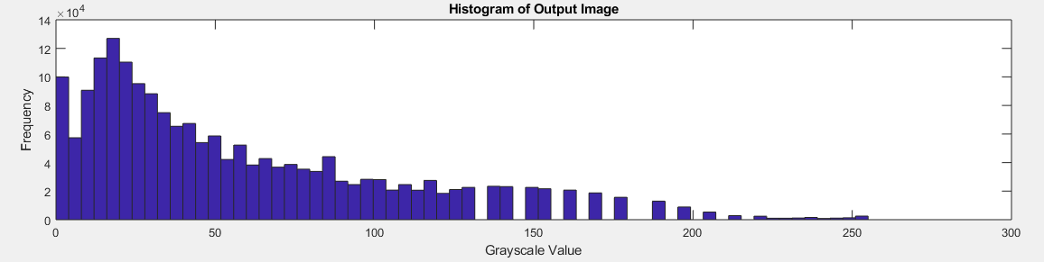
Histogram of Output Image After Matching
After matching, output image having following histogram:
By Sinonalexander - Own work, CC BY-SA 4.0, https://commons.wikimedia.org/w/index.php?curid=68375072

Slide 16
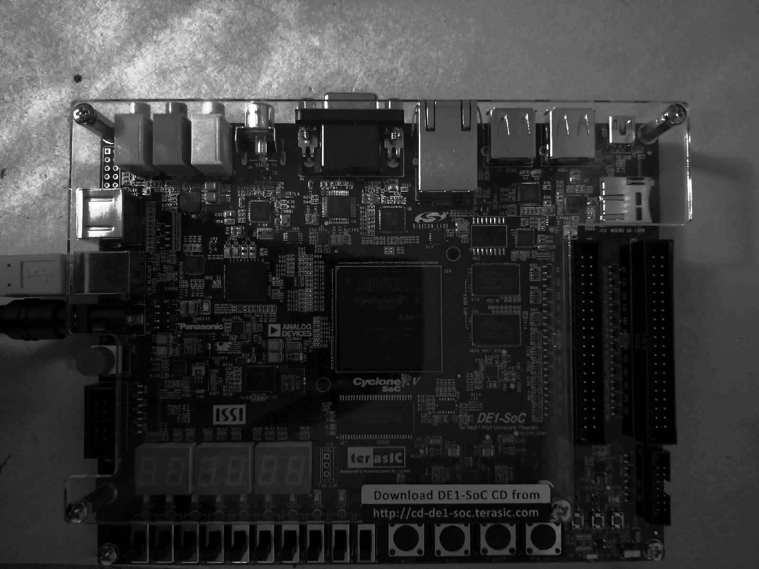
Output image after histogram matching
And looking like this:
By Sinonalexander - Own work, CC BY-SA 4.0, https://commons.wikimedia.org/w/index.php?curid=68375120

Slide 17
Comparison (Again)
Before Histogram Matching:
After Histogram Matching:
By Sinonalexander - Own work, CC BY-SA 4.0, https://commons.wikimedia.org/w/index.php?curid=68375000
By Sinonalexander - Own work, CC BY-SA 4.0, https://commons.wikimedia.org/w/index.php?curid=68375120

Slide 18
Histogram Equalization

Slide 19
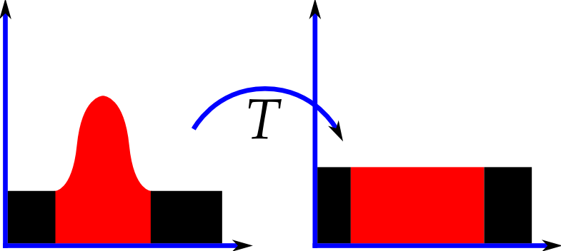
Histogram Equalization
Special case of histogram matching in which a specified histogram is uniformly distributed
A method for contrast adjustment using image histogram
Usually increasing global contrast of many images, especially useful when data in the image is represented by close contrast values

Slide 20
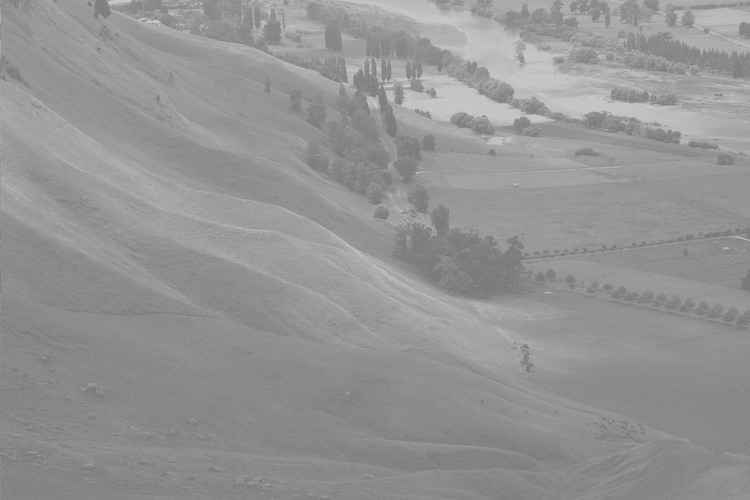
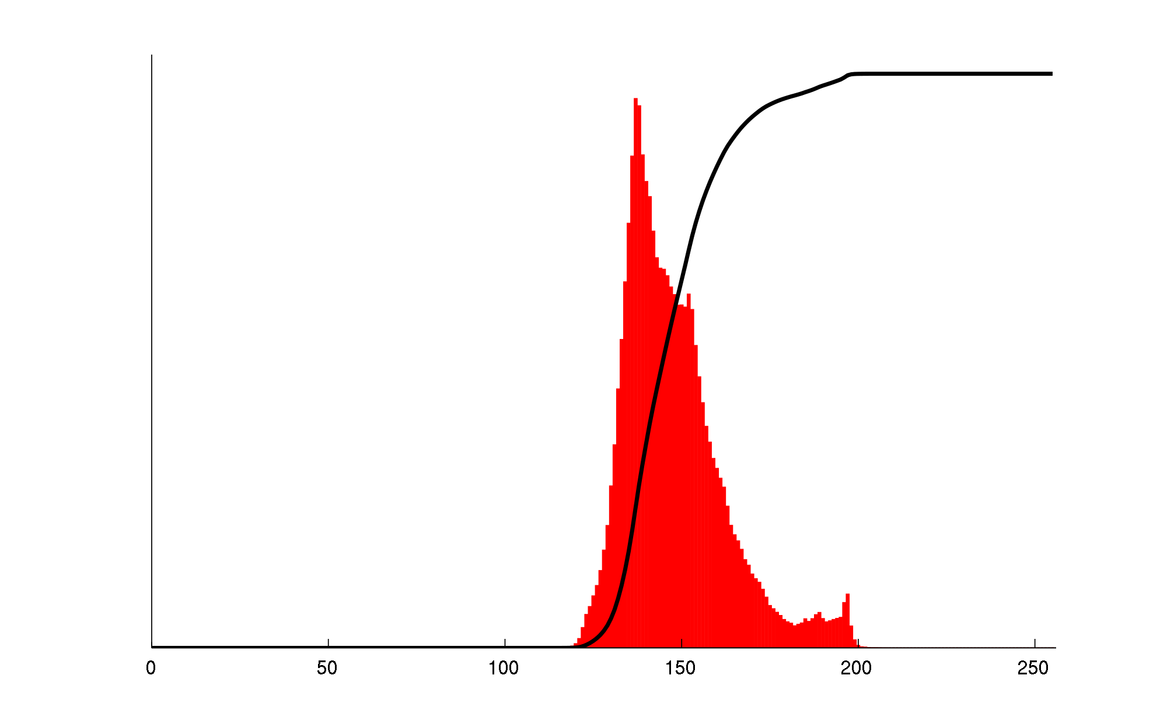
Un-Equalised Image & Histograms – Corresponding (Red)/ Cumulative (Black)
“Unequalised Hawkes Bay NZ” by original Phillip Capper, modified by User:Konstable – modified Hawkes Bay NZ.jpg. Licensed under CC BY 2.0 via Commons – https://commons.wikimedia.org/wiki/File:Unequalized_Hawkes_Bay_NZ.jpg#/media/File:Unequalized_Hawkes_Bay_NZ.jpg

Slide 21
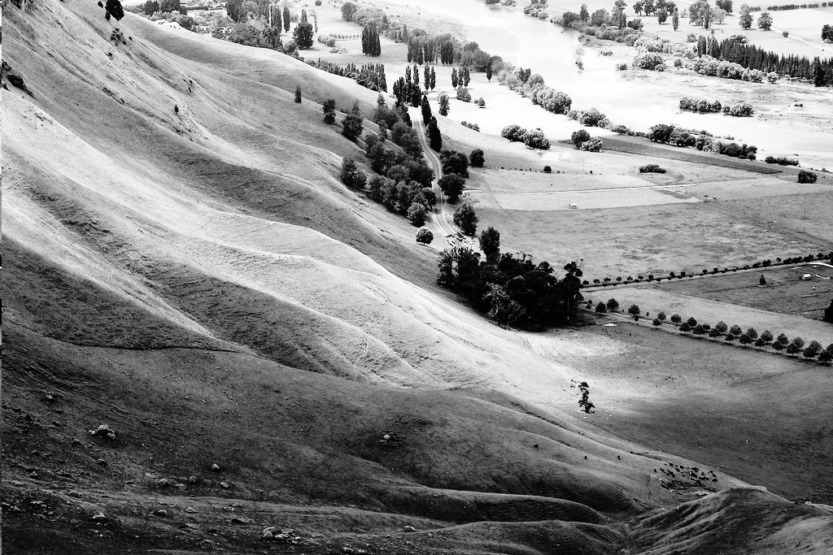
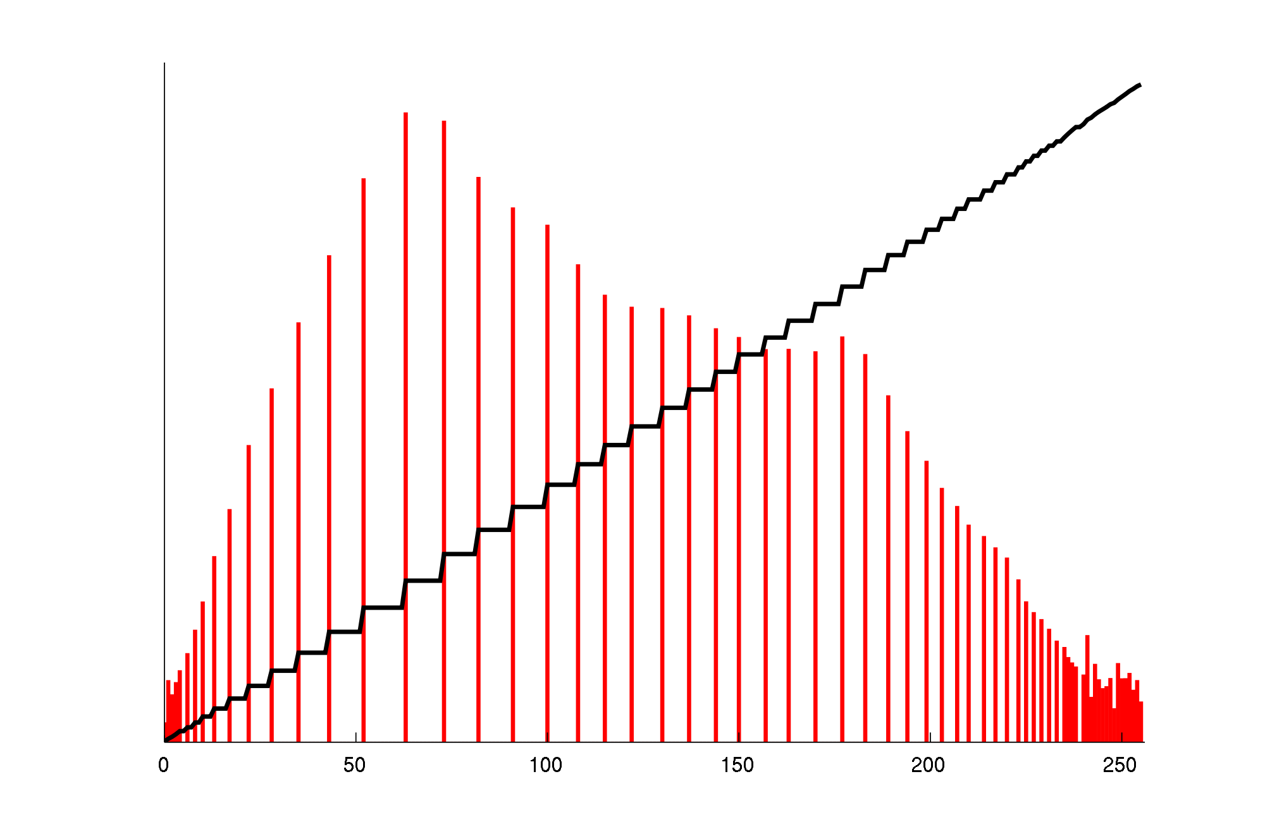
Same Image After Histogram Equalization & Histograms – Corresponding (Red)/ Cumulative (Black)
“Equalized Hawkes Bay NZ” by original Phillip Capper, modified by User:Konstable – modified Hawkes Bay NZ.jpg. Licensed under CC BY 2.0 via Commons – https://commons.wikimedia.org/wiki/File:Equalized_Hawkes_Bay_NZ.jpg#/media/File:Equalized_Hawkes_Bay_NZ.jpg

Slide 22
Image Statistics

Slide 23
Image Statistics
Average deviation of pixel values
Average of pixel values
Kurtosis of pixel values
Min/max pixel value
Location of column/row with min/max pixel value found
Number of points in Region Of Interest (ROI)
Root mean squared of pixel values
Standard deviation of pixel values
Skewness of pixel values

Slide 24
Thank You for Your Attention!

